Slide 1


https://www.vecteezy.com/png/57446607-a-cheerful-little-businessman-carrying-a-briefcase-walks-confidently-on-a-bright-day-in-a-fun-animated-style-little-business-man-illustrationisolated-on-transparent-background
https://gahag.net/005357-medical-doctor/
https://creazilla.com/media/clipart/33960/trevor-medical-doctor-man

Slide 2
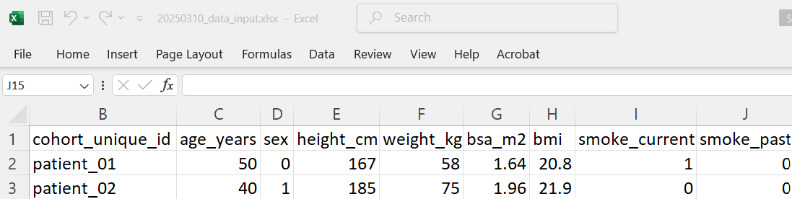
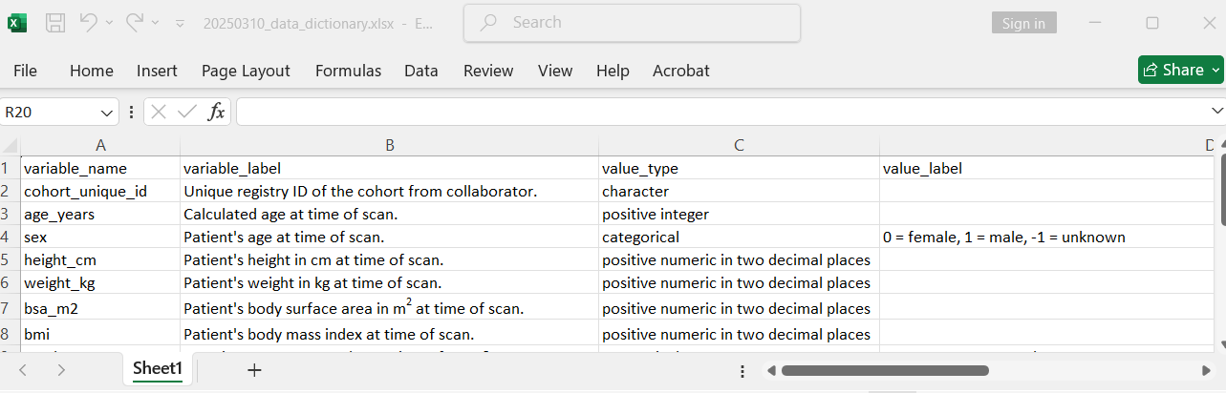
Welcome to the project.
Here is the data dictionary and input template file you can use to send the data.

Slide 3
Received with thanks.
We don’t have an analyst to do the mapping.
We can do it ourselves but our workload allow us to work on one data field per day…

Slide 4
This means it will take at least one year for us to finish (given ~350 data fields to do).
Could we send the data and you do it for us instead ?

Slide 5
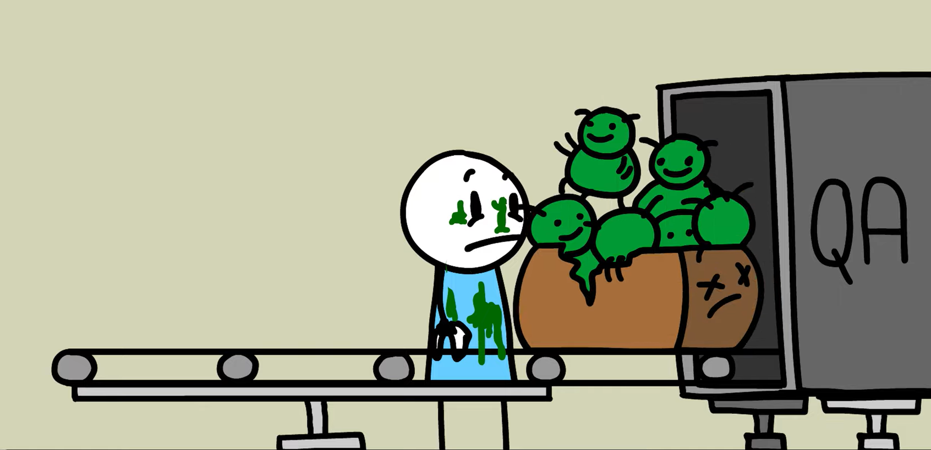
https://www.youtube.com/watch?v=5Z8HDADU57U&ab_channel=MonkeyUser

Slide 7
Could you also send the harmonsied data back to us with a report on how it is done ?
Our higher management needs it for an audit to show that the data is reliable.

Slide 8
Liaise with collaborator on what variables we need and collect them
Return to collaborator cleaned / harmonised dataset and report
Combine/Filter harmonized data from all cohorts
Provide analyst team combined data for further analysis
Harmonise data provided from each collaborator
Provide a data dictionary
Return harmonized data and data dictionary
Send harmonized/ filtered data for study
Provide an input template file
Return cleaning/ harmonization report

Slide 9
Variable Mapping Reporting Workflow
Show examples that the code works
Introduce mapping procedure
Code to validate
Code to do mapping
Clean up variables for merging

Slide 10
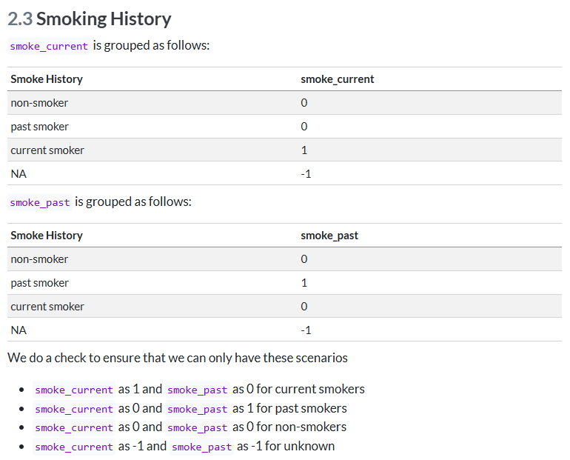
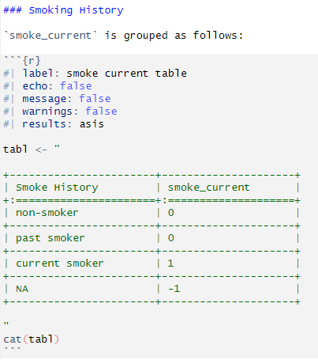
Introduce mapping procedure

Slide 12
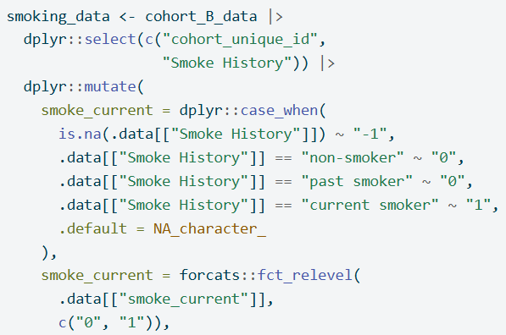
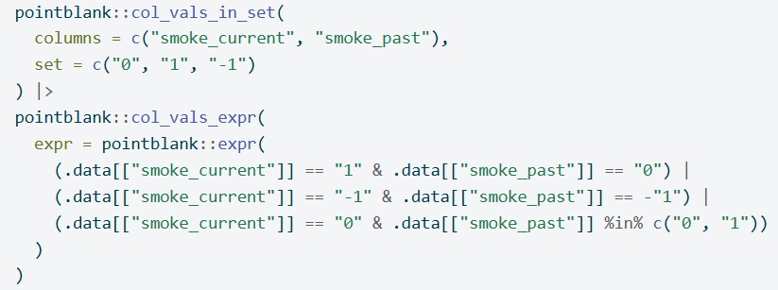
Code to do mapping
Code to validate

Slide 13
Show examples that the code works
Show data

Slide 14
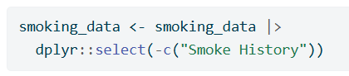
Clean up variables for merging

Slide 15
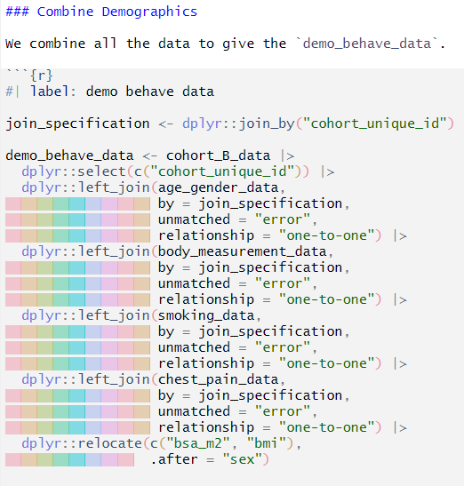

Slide 16
https://www.vecteezy.com/vector-art/464863-businessman-kneel-on-floor-with-pointing-finger-to-him
Businessman kneel on floor with pointing finger to him Free Vector Vecteezy! Amonrat Rungreangfangsai

Slide 17
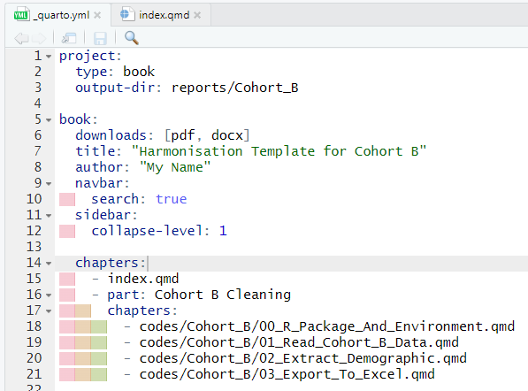
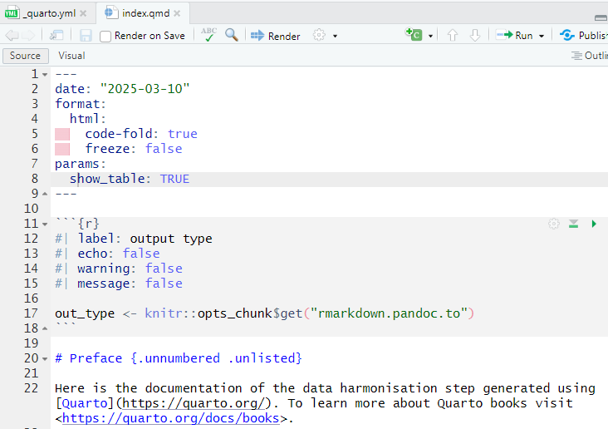

Slide 18
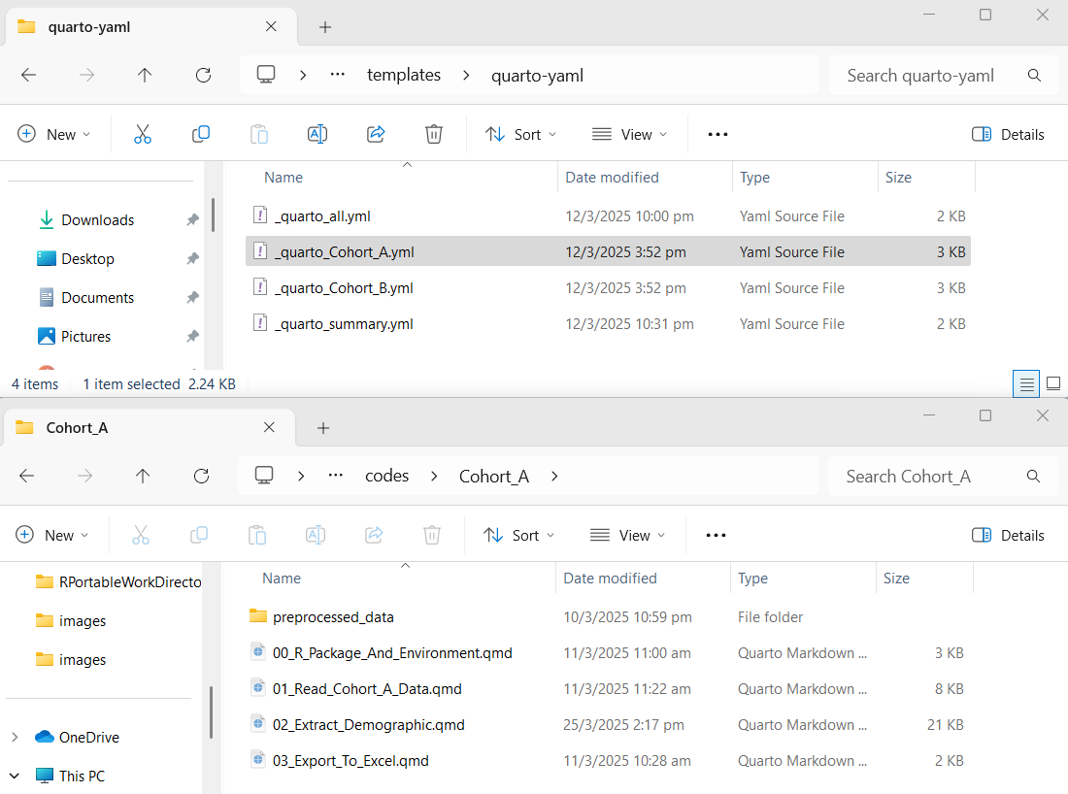

Slide 19
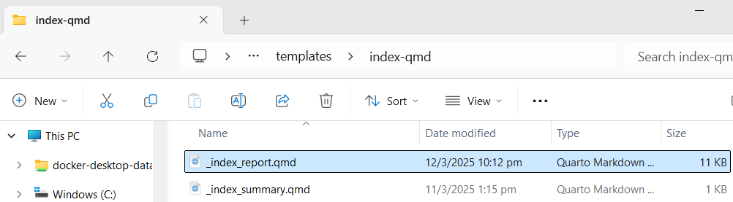
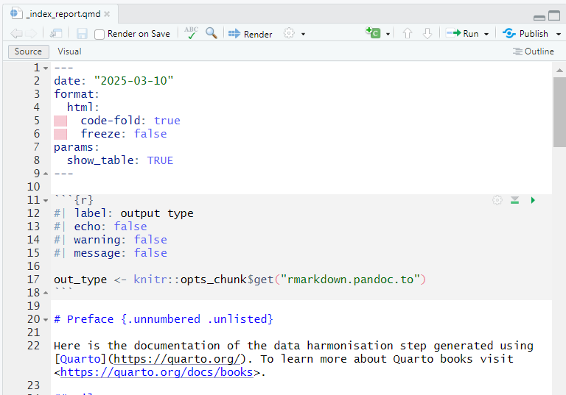

Slide 20
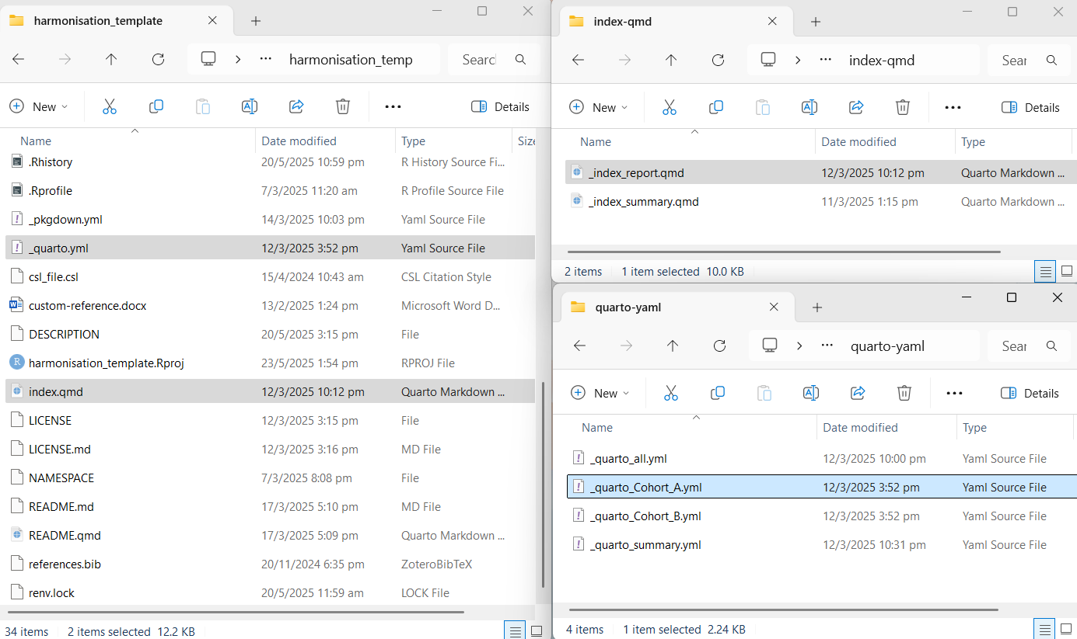

Slide 22
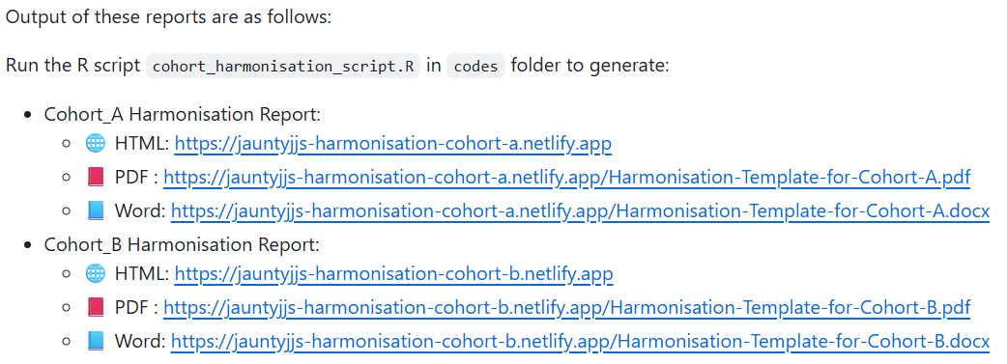
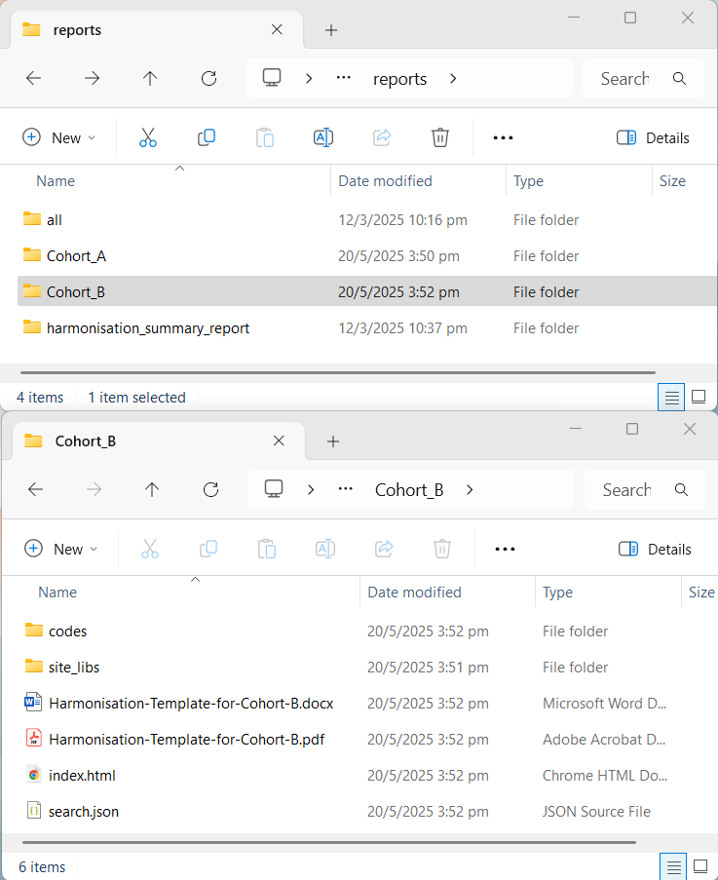

Slide 23
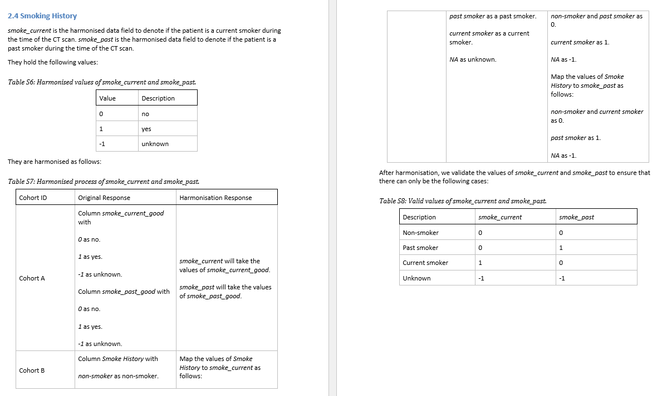

Slide 24
Patient | smoke_history | smoke_current | smoke_past
Current smoker | 1 | 1 | 0
Past smoker | 1 | 0 | 1
Non-smoker | 0 | 0 | 0
Have smoking history | 1 | -1 | -1
Missing | -1 | -1 | -1
Patient | smoke_history | Problem
Non-smoker | 0 | No smoking history
Current smoker | 1 | Have smoking history
Past smoker | 2
Missing | -1 | Missing

Slide 25
 |  |  |  | 10
 |  |  |  | Age
 |  |  |  | Sex
 |  |  |  | Hypertension
 |  |  |  | Dyslipidemia
 |  |  |  | Family Hx CAD
 |  |  |  | Diabetes
 |  |  |  | Smoke Current
 |  |  |  | Smoke Past |  |  | 2 | 2 | 2
 |  |  |  | Have Chest Pain | 1 | 1 | Height | HDL | Triglyceride
Country | Cohort | N | Variables | Chest Pain Character | Dyspnea | BMI | Weight | Total Cholesterol | LDL
Country A | Cohort A | 1000 | 15 | ✔ | ✔ | ✔ | ✔ | ✖ | ✖
 | Cohort B | 2000 | 16 | ✔ | ✔ | ✖ | ✖ | ✔ | ✔
Country B | Cohort C | 1500 | 18 | ✔ | ✔ | ✔ | ✔ | ✔ | ✔
Country C | Cohort D | 500 | 16 | ✔ | ✖ | ✔ | ✖ | ✔ | ✔
Country D | Cohort E | 1000 | 16 | ✔ | ✖ | ✔ | ✔ | ✔ | ✖
 | Cohort F | 2500 | 14 | ✔ | ✖ | ✔ | ✔
Total |  |  |  | 8500 | 4500 | 6500 | 6000 | 5000 | 4000
Variable Colour Legend
 | Age
 | Sex
 | Comorbidity
 | Smoking history
 | Symptoms
 | Obesity
 | Blood lipid
Table Legend
✔ | Available
✖ | Not available
 | Pending arrival

Slide 26
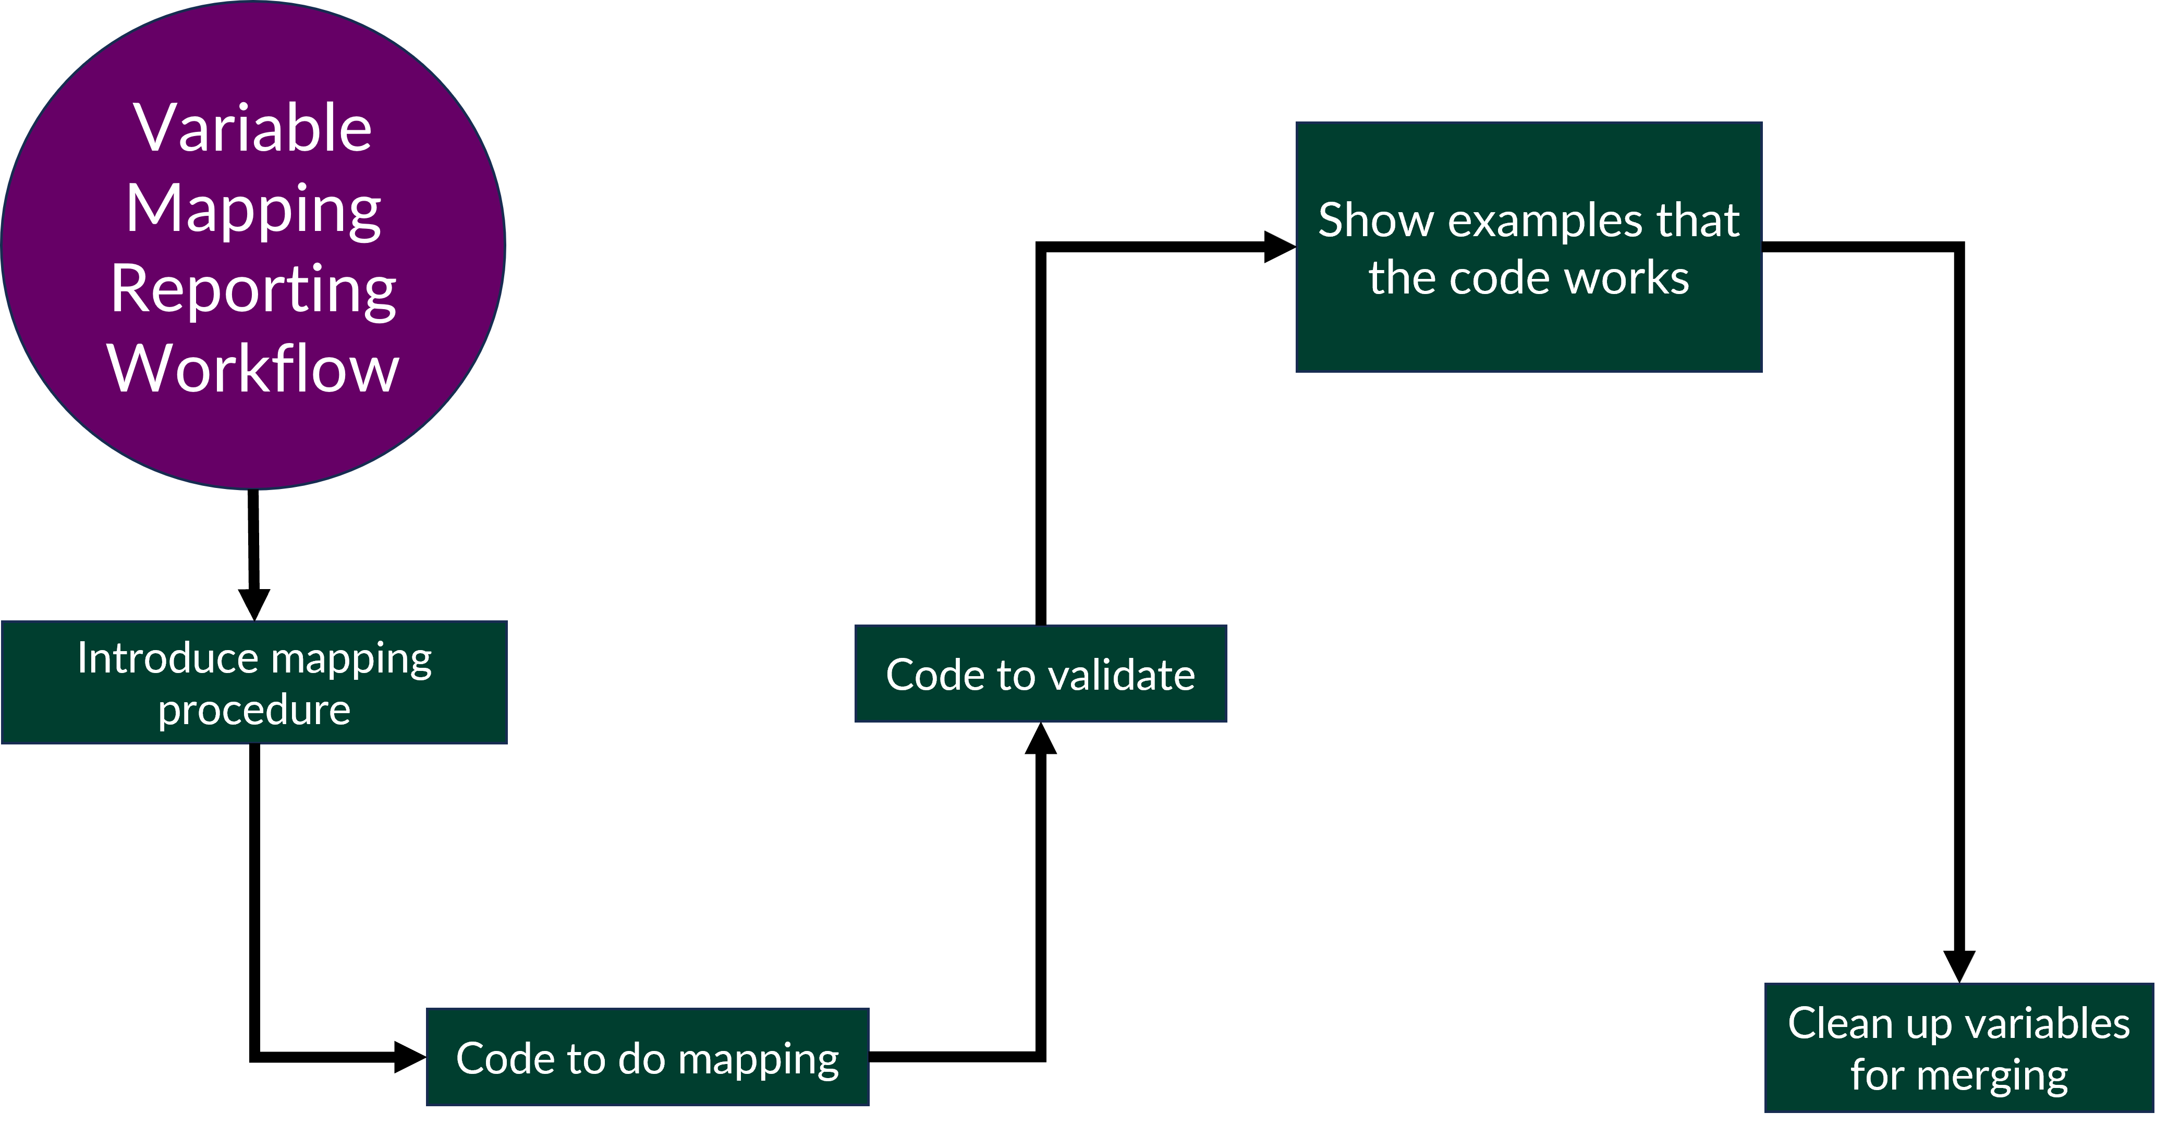
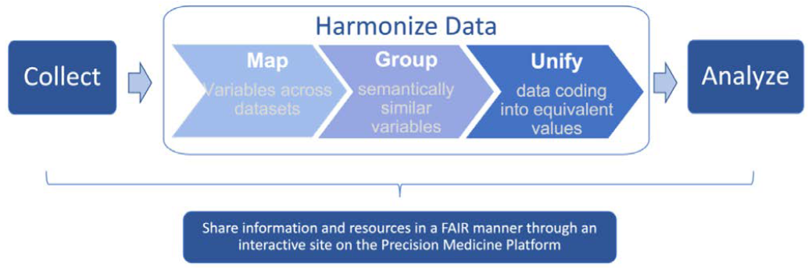
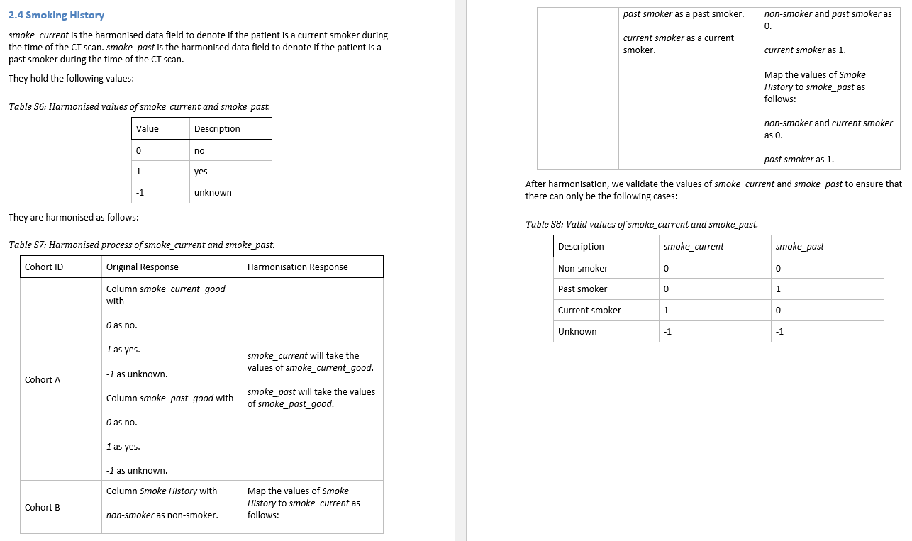
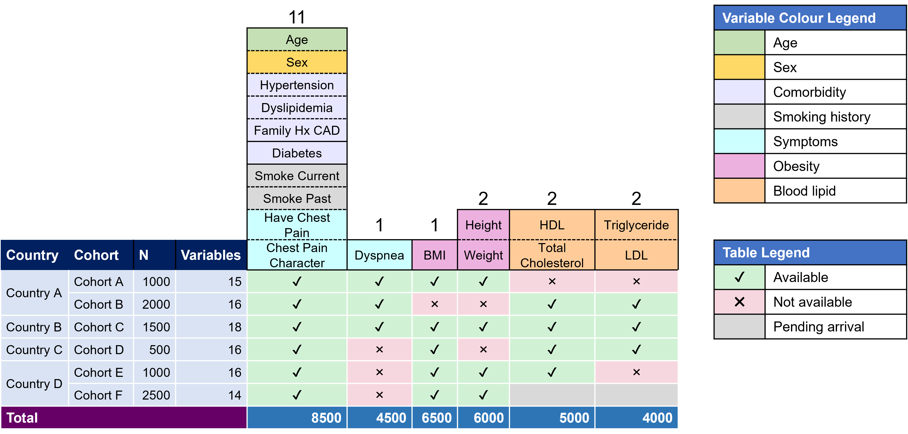

Slide 27

[Dataset vectors](https://www.vecteezy.com/vector-art/25844300-abstract-database-info-silhouette-illustration) by [Vectora Artworks](https://www.vecteezy.com/members/vectoroartworks) from [Vecteezy](https://www.vecteezy.com/)

Slide 28



Clean for harmonisation
Harmonise
Raw Data
Cleaned Data
Harmonised Data
Verify/Update
Verify/Update
[Dataset vectors](https://www.vecteezy.com/vector-art/25844300-abstract-database-info-silhouette-illustration) by [Vectora Artworks](https://www.vecteezy.com/members/vectoroartworks) from [Vecteezy](https://www.vecteezy.com/)

Slide 29
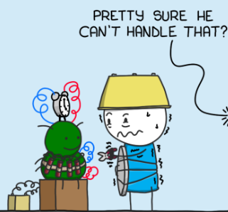
Clean for harmonisation
Harmonise
Raw Data
Cleaned Data
Harmonised Data
Verify/Update
Verify/Update
[Dataset vectors](https://www.vecteezy.com/vector-art/25844300-abstract-database-info-silhouette-illustration) by [Vectora Artworks](https://www.vecteezy.com/members/vectoroartworks) from [Vecteezy](https://www.vecteezy.com/)

Slide 30
Thank you for the harmonised data.
Could we also have the corrected “raw” version of the data as well ?
Harmonised Data

Slide 31
Here is the corrected “raw” version of the data.
Cleaned Data
Harmonised Data

Slide 32
Clean for harmonisation
Harmonise
Verify/Update
Raw Data
Cleaned Data
Harmonised Data
Verify/Update
[Dataset vectors](https://www.vecteezy.com/vector-art/25844300-abstract-database-info-silhouette-illustration) by [Vectora Artworks](https://www.vecteezy.com/members/vectoroartworks) from [Vecteezy](https://www.vecteezy.com/)

Slide 33
Cohort 1 Race/Ethnicity
Chinese
Indian
Malay
Eurasian
Others
Cohort 2 Race/Ethnicity
White
Black
Asian
Mixed
Others
Cohort 4 Race/Ethnicity in text
Latino | Brazilian
White | British
Asian | Chinese
Middle Eastern | Egyptian
Asian | Korean
Asian | Filipino
White | German
Asian | Japanese
Asian | Korean
Asian | Pakistani
Latino | Peruvian
Middle Eastern | Saudi Arabian
African | Ugandan
etc …
New Cohort Race/Ethnicity
White
African
Southeast Asian
East Asian
South Asian
Other Asians
Middle Eastern
Torres Straits Islanders
Aboriginal
Others
Cohort 3 Race/Ethnicity
Race | Ethnicity
White | Hispanic/Latino
Black | Not Hispanic/Latino
Asian
Native American
Pacific Islanders
Others

Slide 34
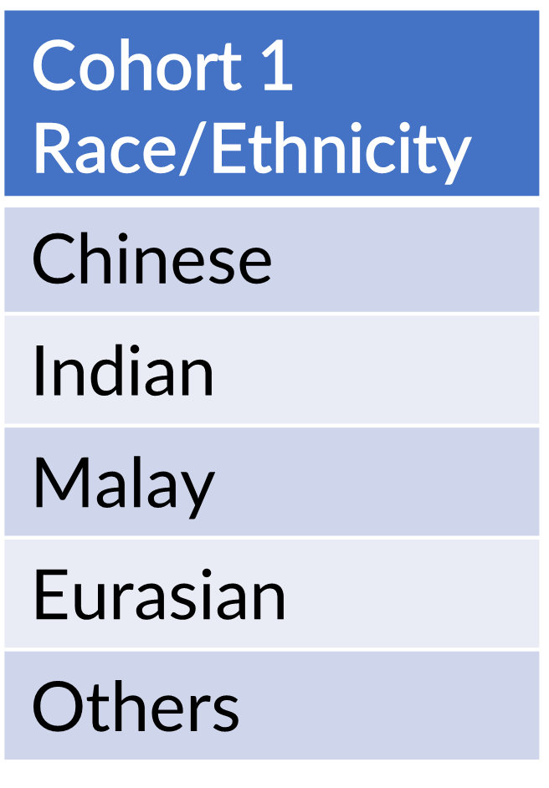
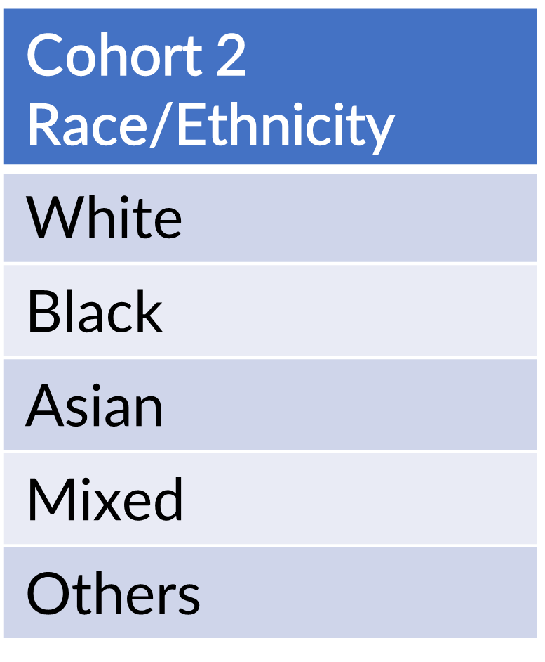
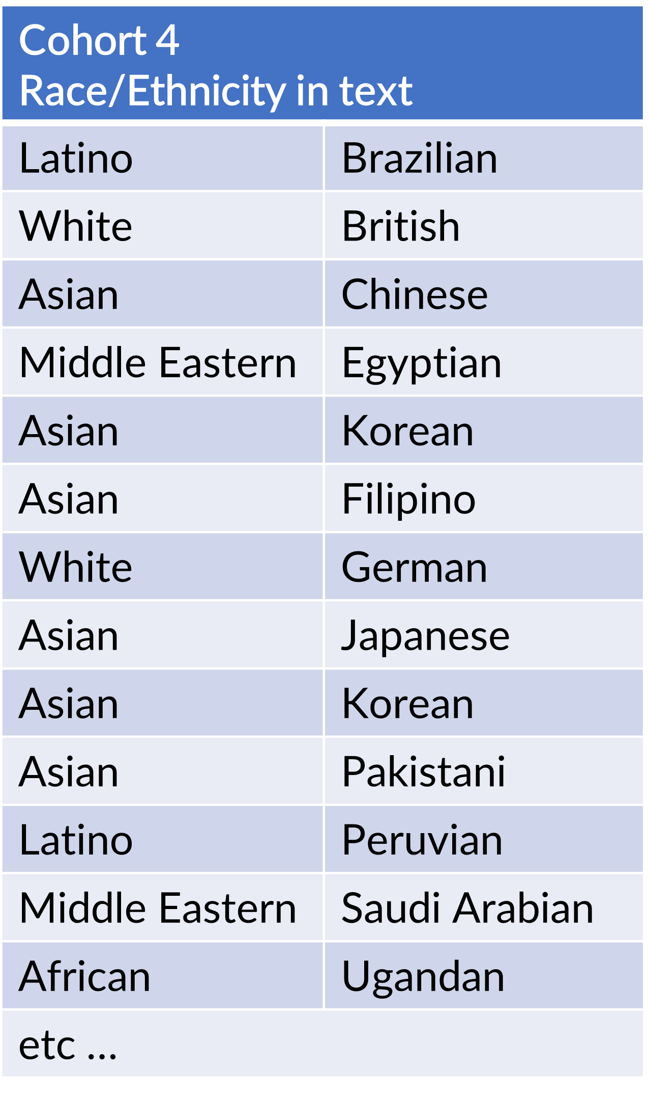
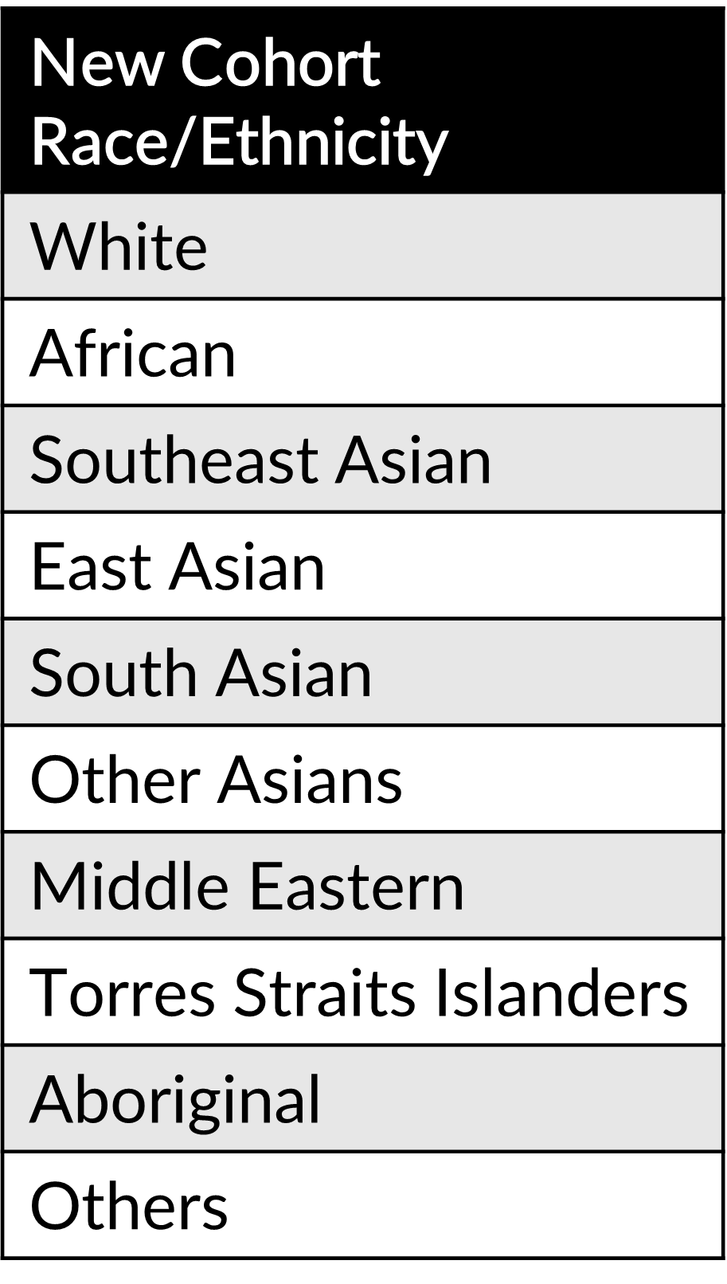
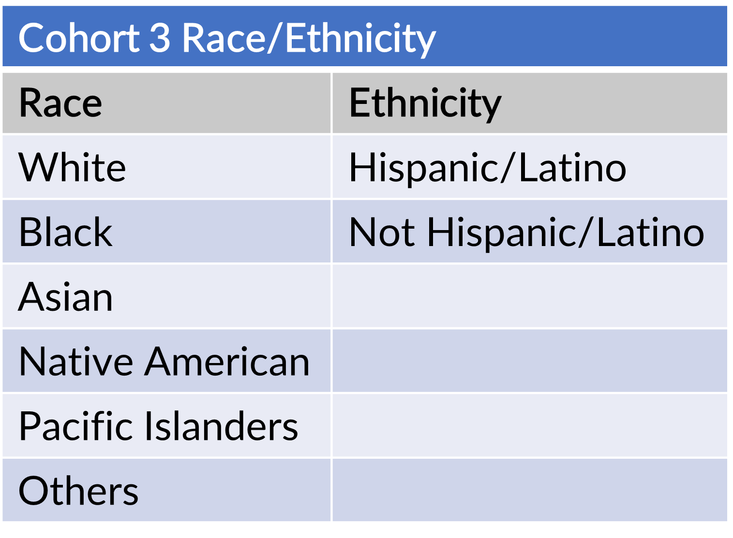

Slide 35
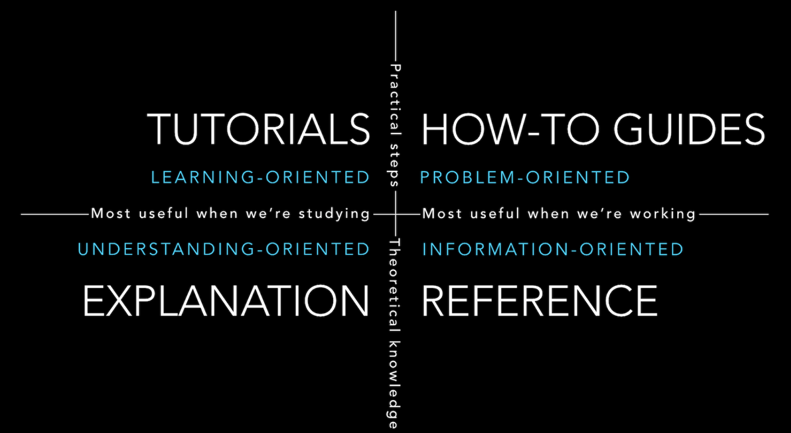

Slide 36
overview Harmonisation approach For journal article or presentation
Table showing how a data field is HARmonised for each cohort
Practical Steps
Learning-oriented
PROBLEM-oriented
Useful for paper/presentation
Useful when working on data
Understanding-oriented
Information-oriented
Supplementary document to explain WHY RACE/ETHNICity is harmonised into ...
Variable mapping Technical Report AS SEEN so FAR
Theoretical Knowledge

Slide 37


https://www.cleanpng.com/png-scalable-vector-graphics-cran-statgraphics-rnn-vit-6890332/download-png.html
https://rstudio.github.io/cheatsheets/html/quarto.html
[[R Programming Logo](https://www.cleanpng.com/png-scalable-vector-graphics-cran-statgraphics-rnn-vit-6890332/download-png.html){target="_blank"} from [CleanPNG](https://www.cleanpng.com/){target="_blank"}]{style="font-size: 60%;"}.
[[Quarto Hex Sticker](https://rstudio.github.io/cheatsheets/html/quarto.html){target="_blank"} from [Posit](https://posit.co/){target="_blank"}]{style="font-size: 60%;"}.

Slide 38
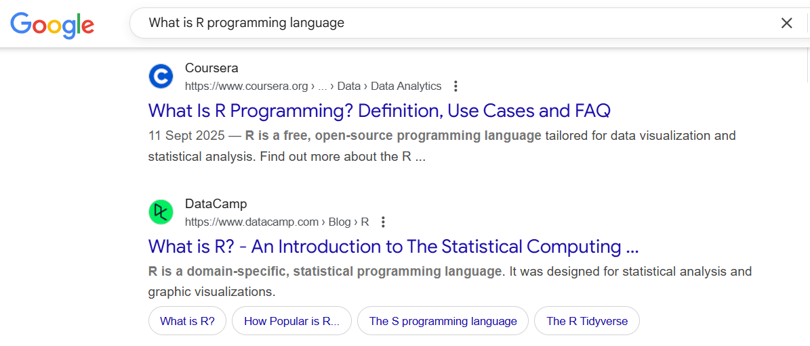

Slide 39
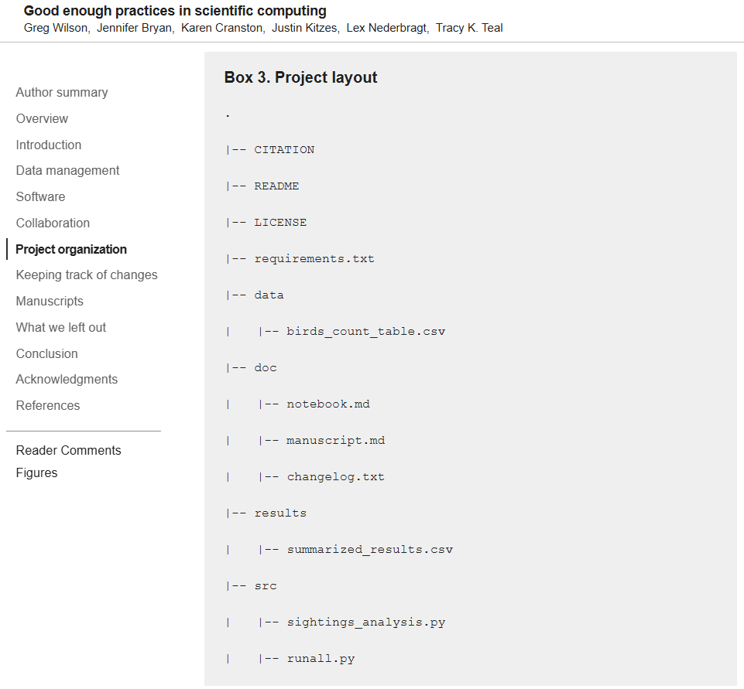

[[Research Compendium](https://book.the-turing-way.org/reproducible-research/compendia/){target="_blank"} by Scriberia from [The Turing Way project](https://book.the-turing-way.org/){target="_blank"}]{style="font-size: 60%;"}.
[[Project Layout] from [Good enough practices in scientific computing](https://journals.plos.org/ploscompbiol/article?id=10.1371/journal.pcbi.1005510){target="_blank"}]{style="font-size: 60%;"}.

Slide 40
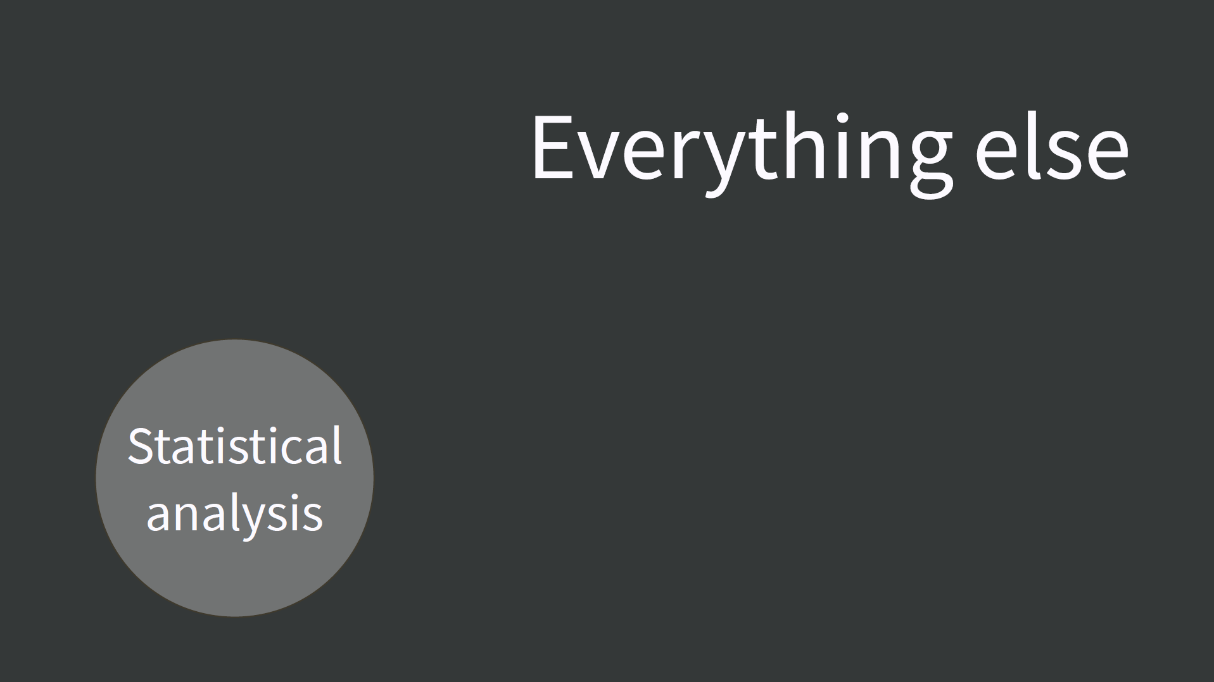

Slide 41
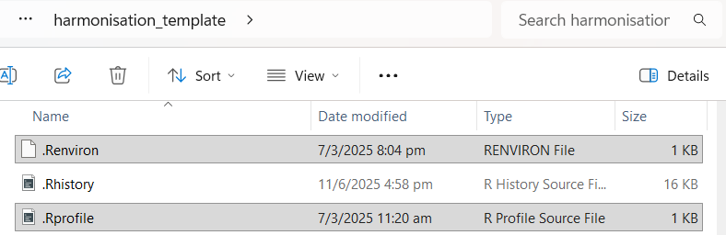

Slide 42
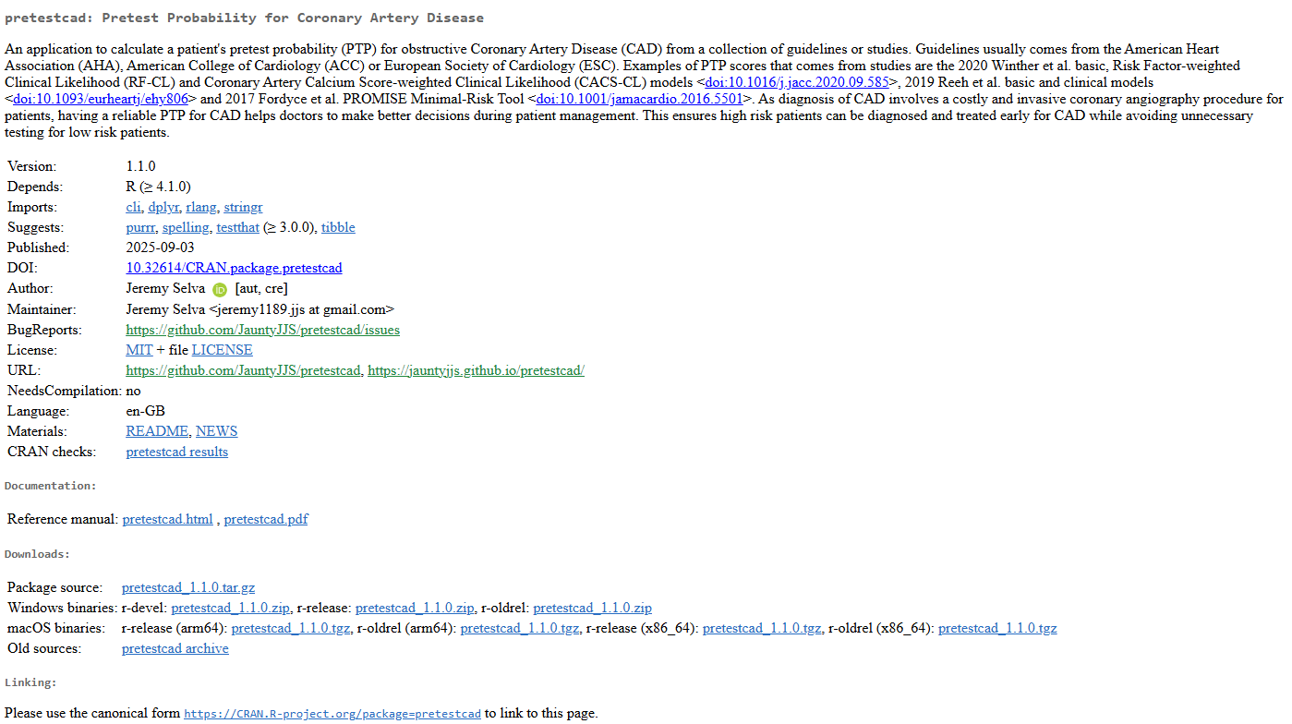

Slide 43
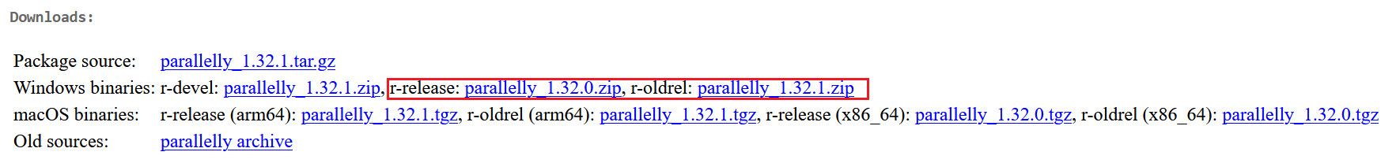
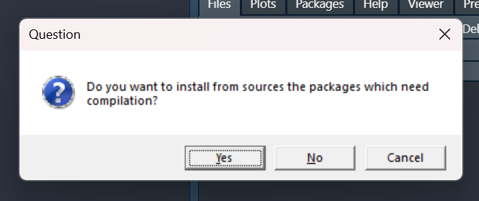

Slide 44
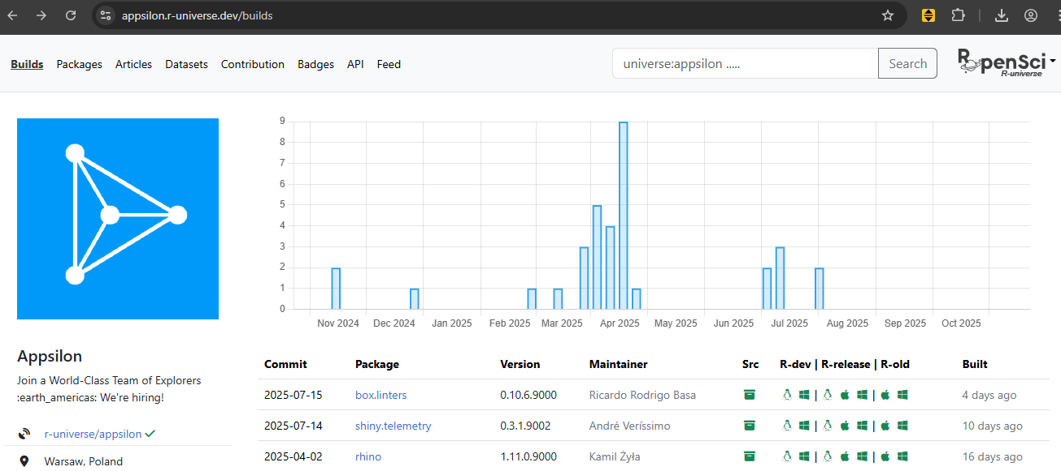
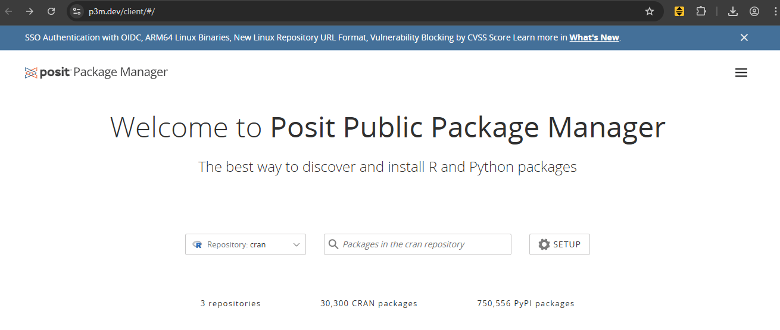

Slide 45
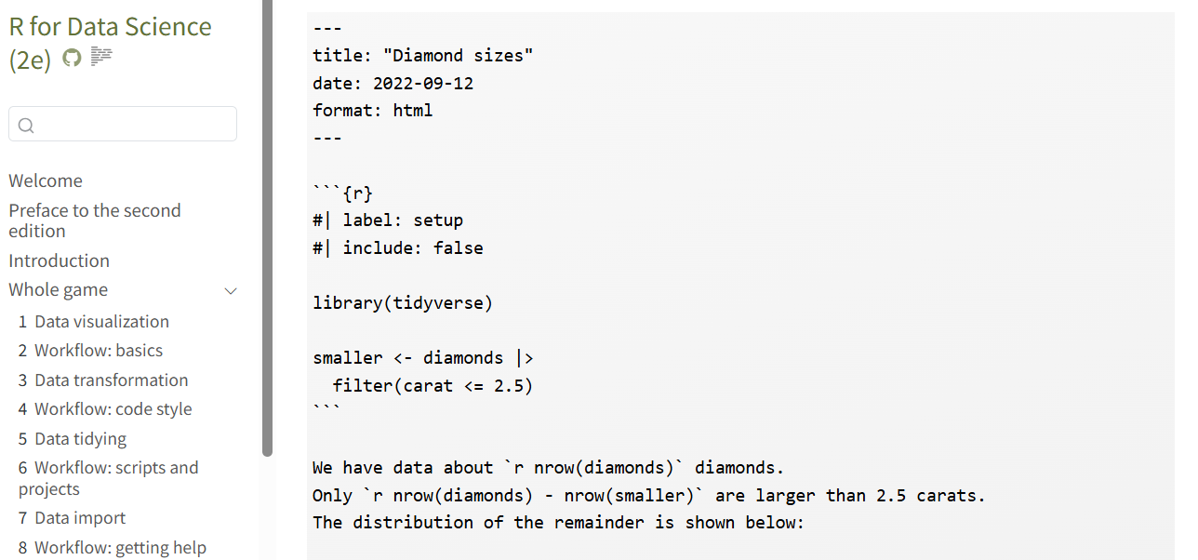
An (optional) YAML header surrounded by `---`s.
Chunks of R code surrounded by ```s.
Text mixed with markdown text formatting.
Quarto file example from [R for Data Science (2e) Chapter 28 Quarto](https://r4ds.hadley.nz/quarto.html#quarto-basics)

Slide 46
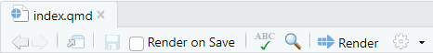
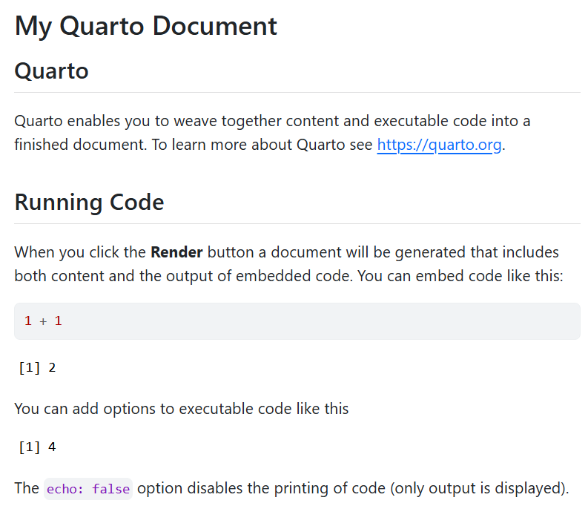
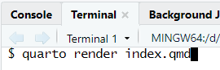
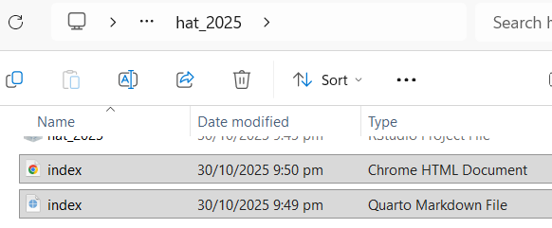

Slide 47
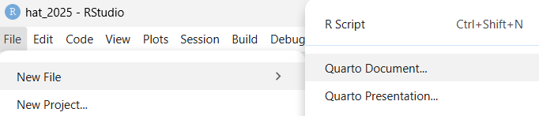
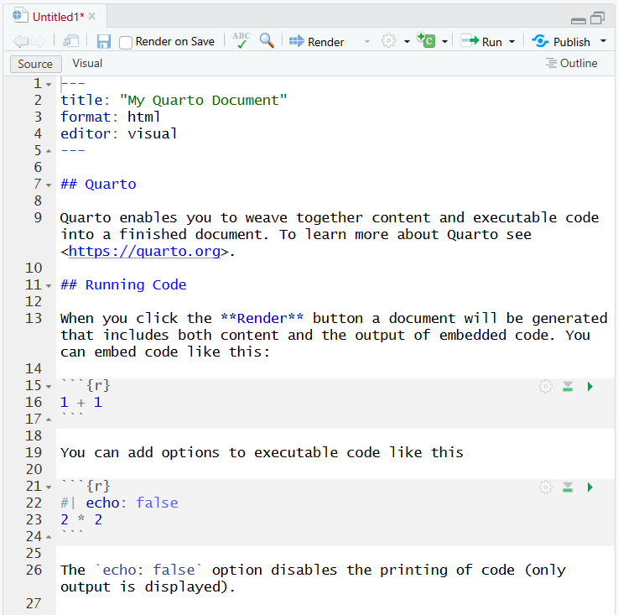
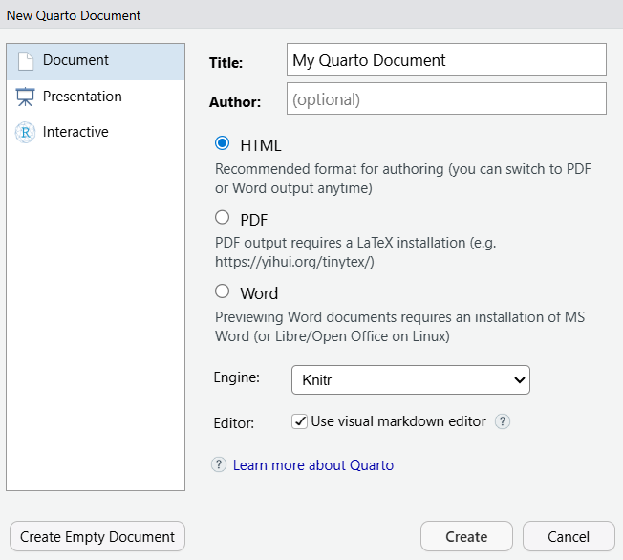

Slide 48
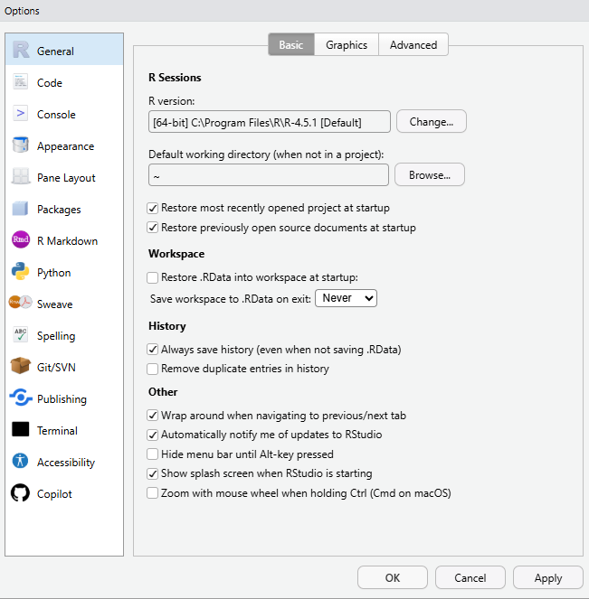

Slide 49





Slide 50
Development
Source
Bundled
Binary
devtools:build()
devtools:build(binary=TRUE)
User
Binary
install.packages()
pak::pak()
renv::install()
Installed
Loaded
library()

Slide 51
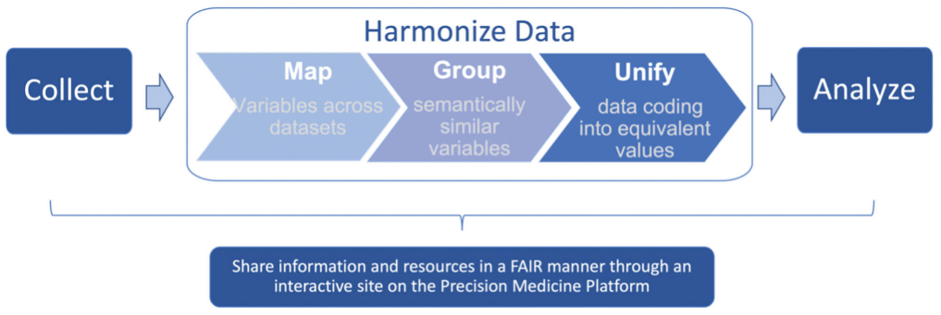


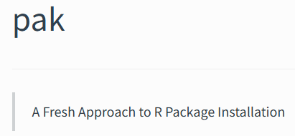
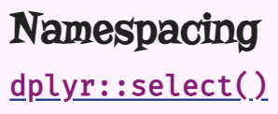





R Administration
Project Organisation

Slide 52




Slide 53


